Slide 1
Change Detection Class 7

Slide 2
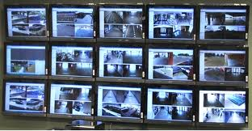
Where to look?

Slide 3
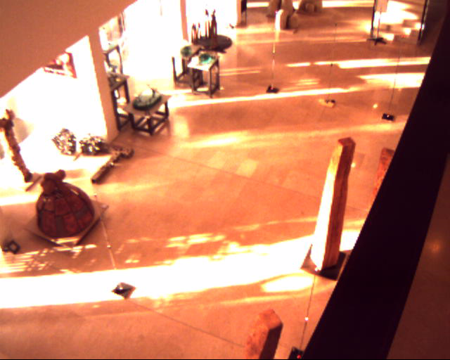
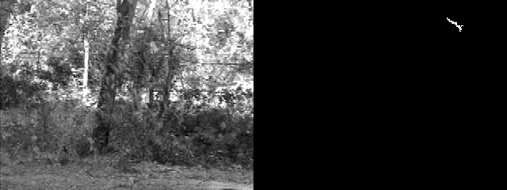
Change Detection
Motion detection - attention
Boring

Slide 4
Object Segmentation
Using background subtraction

Slide 5
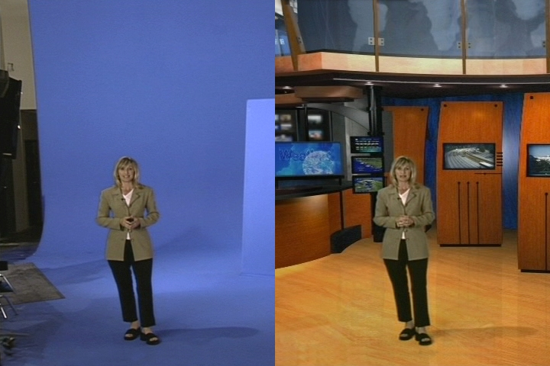
Making life simple
Borrowed from Alexei Efros, CMU, Fall 2005

Slide 6
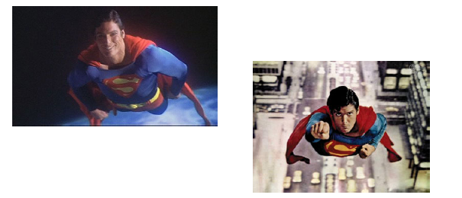
How does Superman fly?
Image Matting and Compositing?
Borrowed from Alexei Efros, CMU, Fall 2005

Slide 7
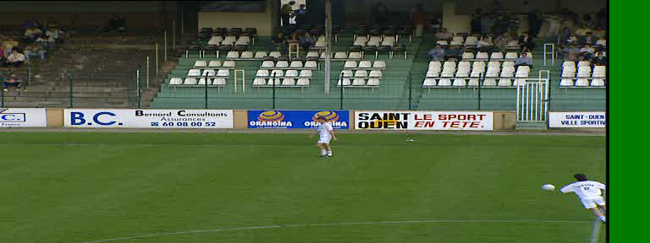
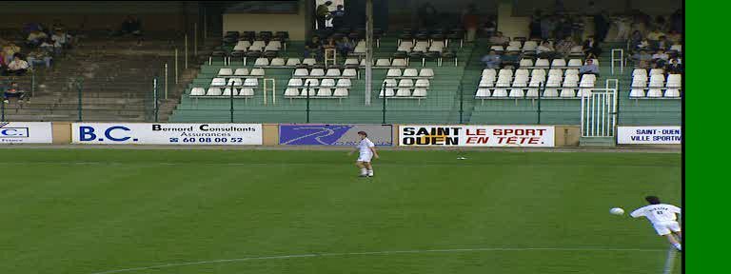
Another Application

Slide 8
Simple Change Detection
Problem: detect the moving regions in the scene
Input: a sequence of frames taken from a fixed camera (e.g., by a surveillance camera)
Output: for each pixel determine if it belongs to the foreground or background
Extension:
Moving camera
Segmentation
Regions rather than pixels

Slide 9
Background Subtraction
Input:
A sequence of n images: I₁,I₂,…,I_{n}
A threshold: th
Naive algorithm:
Learn the background, I_{B}
Compute the point wise difference d_{k}(x,y)=|I_{B}(x,y)-I_{k}(x,y)|
If |d_{k}(x,y)|>th label (x,y) as moving

Slide 10
Background Model: Pixel
Which frame to use?
When is it enough?
A single image
Statistic on a set of frames
Average
Median
A Gaussian
A (weighted) mixture of Gaussians
How to compute?
How to update?

Slide 11
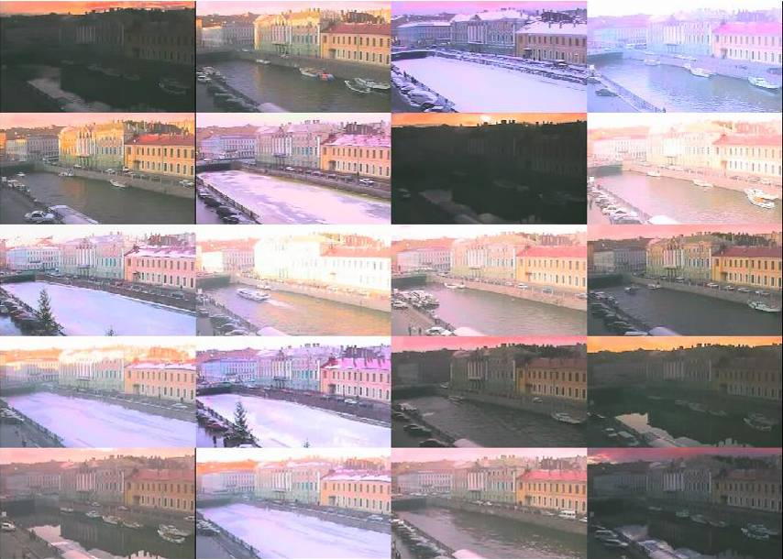
Example
Borrowed from Alexei Efros, CMU, Fall 2005

Slide 12

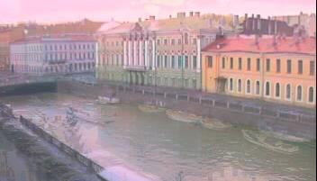
Average image
Median Image
Borrowed from Alexei Efros, CMU, Fall 2005

Slide 13
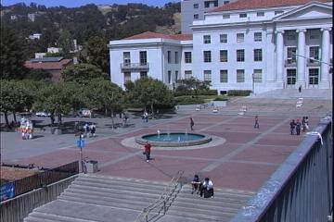
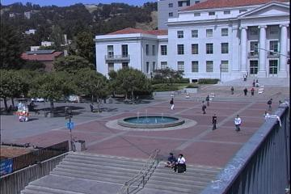
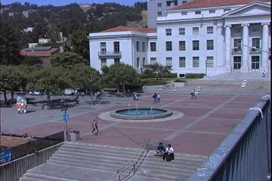



Average/Median Image
Borrowed from Alexei Efros, CMU, Fall 2005

Slide 14
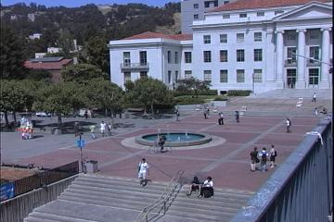

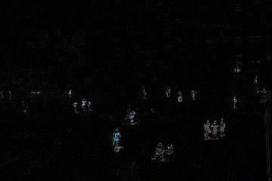
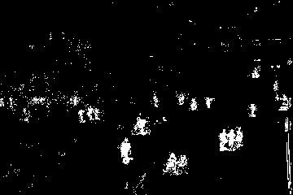
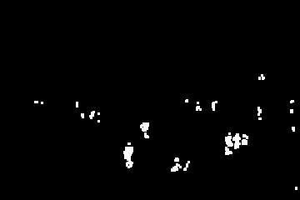
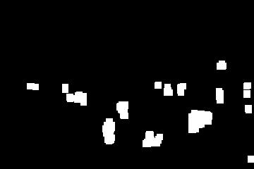
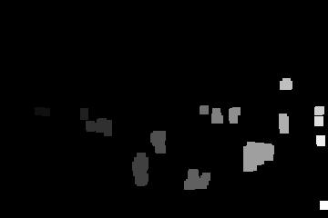
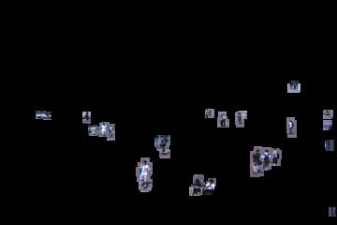
Background Subtraction
-
=
Borrowed from Alexei Efros, CMU, Fall 2005

Slide 15
Limitations
A global threshold
Set a different threshold to each pixel
Setting the threshold
Set it automatically
Changing background
Update it
Cope with multiple modal background
Keep multimodal

Slide 16
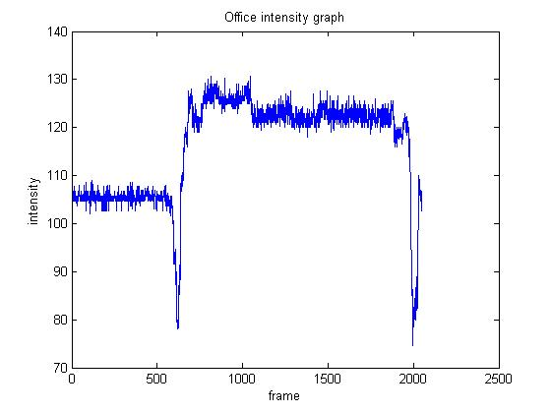
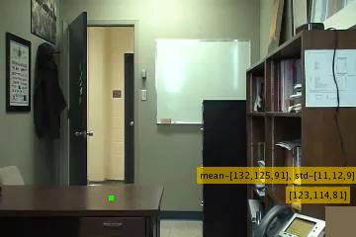
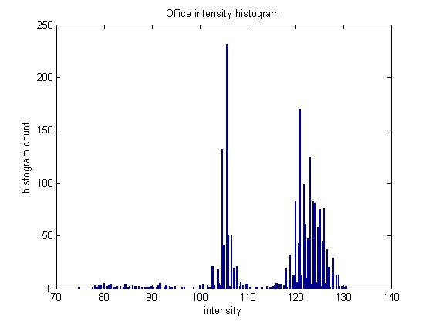
Exmple1

Slide 17
Parametric Pixel Modeling

Slide 18
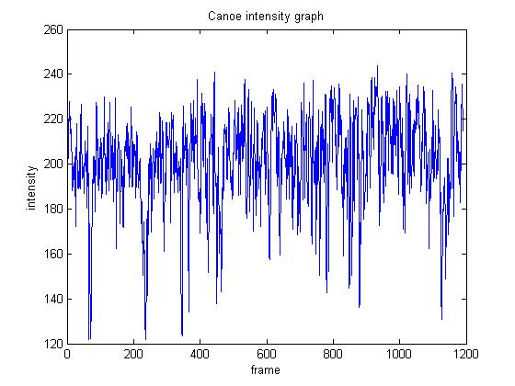
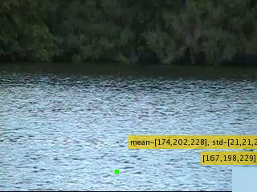
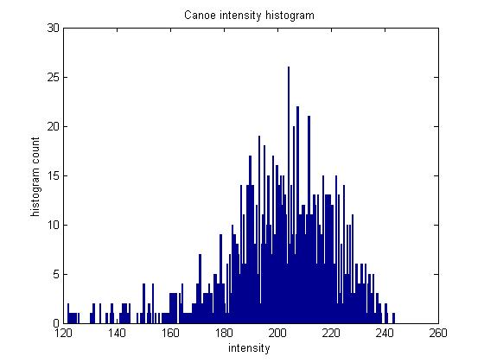
Example 2

Slide 19
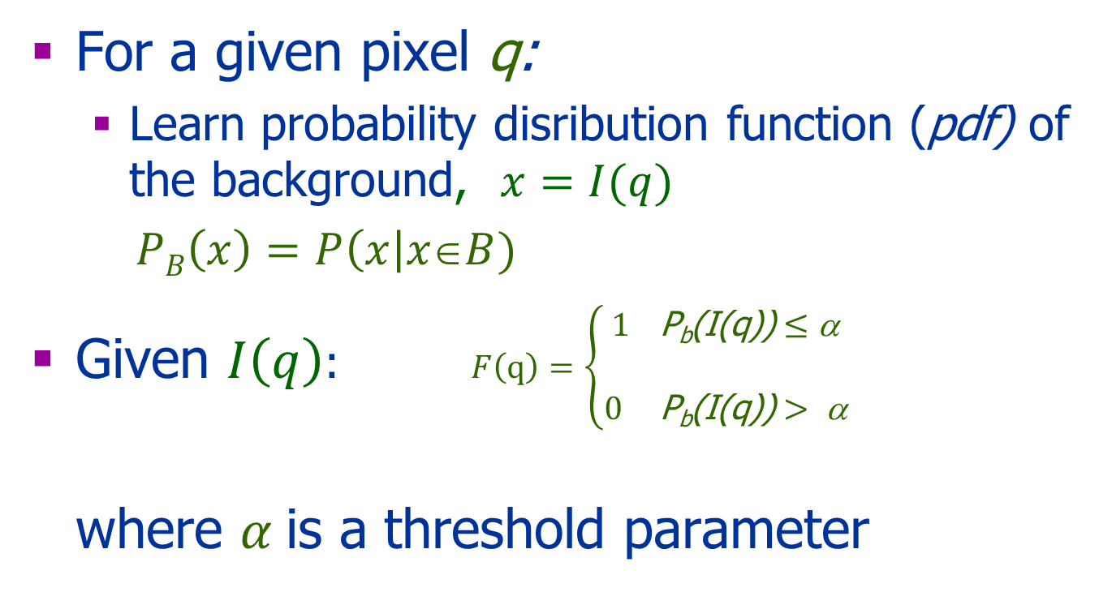
Background Distribution
For a given pixel q:
Learn probability disribution function (pdf) of the background, $x=I(q)$
$PB\left(x\right)=P\left(x\right|x∈B)$
Given $I\left(q\right):$ $F\left(q\right)=\left\{\begin{aligned}1 \text{P}\text{b}\text{(}\text{I}\text{(}\text{q}\text{))}≤\text{α} \\ \\ 0 \text{P}\text{b}\text{(}\text{I}\text{(}\text{q}\text{))}> \text{α}\end{aligned}\right.$ where $α$is a threshold parameter

Slide 20
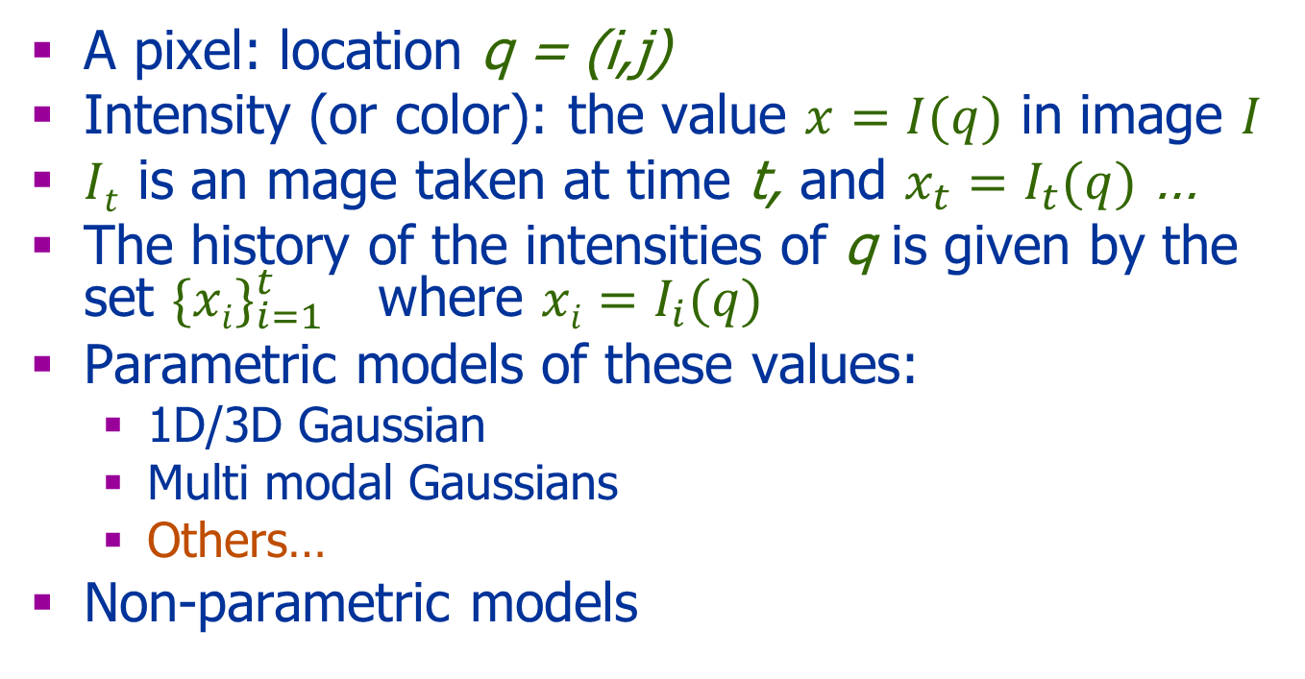
Model the pdf
A pixel: location q = (i,j)
Intensity (or color): the value $x=I(q)$ in image $I$
$It$ is an mage taken at time t, and $x_{t}=I_{t}(q)$ …
The history of the intensities of q is given by the set ${\{xi\}}_{i=1}^{t}$ where $xi=I_{i}(q)$
Parametric models of these values:
1D/3D Gaussian
Multi modal Gaussians
Others…
Non-parametric models

Slide 21
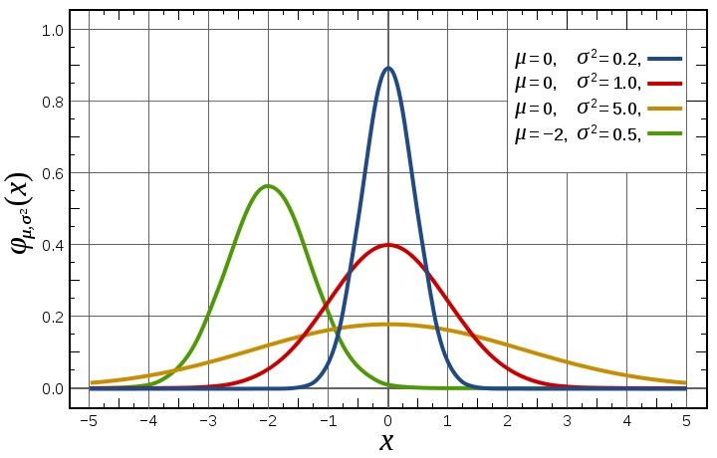

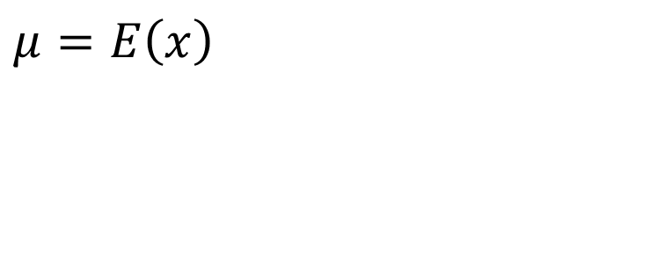
Model: 1D Gaussian
Assume: independent Gaussian noise in the sampling process
Parameters:
μ - mean
σ - STD
σ² - Variance
$μ=E\left(x\right)$
$$σ^{2}\left(x\right)=E\left[{\left(x−μ\right)}^{2}\right]$$

Slide 22
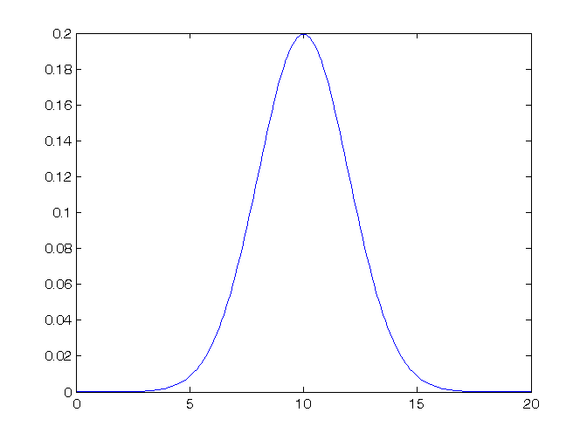
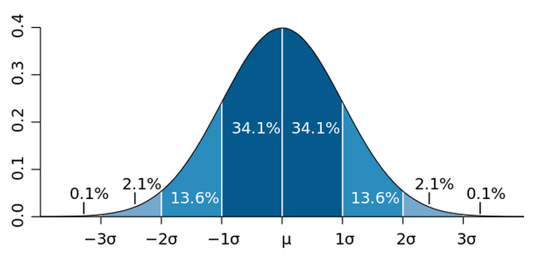
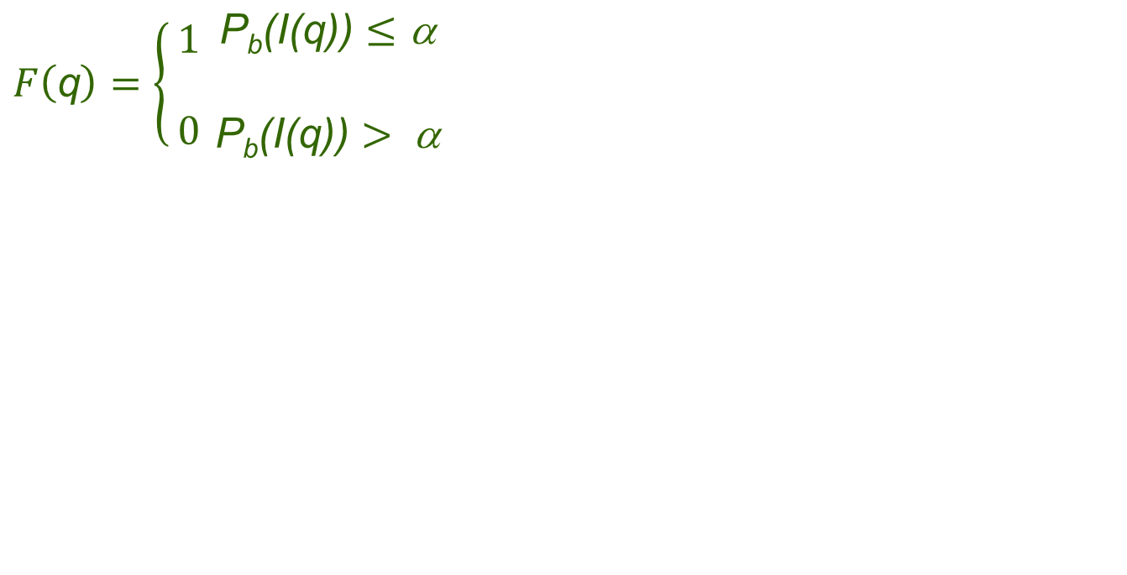

How to set the threshold α?
$$F\left(\text{q}\right)=\left\{\begin{matrix}\begin{aligned}1 \\ \end{aligned} \\ 0\end{matrix}\right.\begin{matrix}\text{P}\text{b}\text{(}\text{I}\text{(}\text{q}\text{))}≤\text{α} \\ \begin{matrix} \\ \text{P}\text{b}\text{(}\text{I}\text{(}\text{q}\text{))}> \text{α}\end{matrix}\end{matrix}$$
α
Fg
Bg
Fg

Slide 23
How to set α?
Where are the failures?
$$F\left(\text{q}\right)=\left\{\begin{matrix}\begin{aligned}1 \\ \end{aligned} \\ 0\end{matrix}\right.\begin{matrix}\text{P}\text{b}\text{(}\text{I}\text{(}\text{q}\text{))}≤\text{α} \\ \begin{matrix} \\ \text{P}\text{b}\text{(}\text{I}\text{(}\text{q}\text{))}> \text{α}\end{matrix}\end{matrix}$$
α
Fg

Slide 24
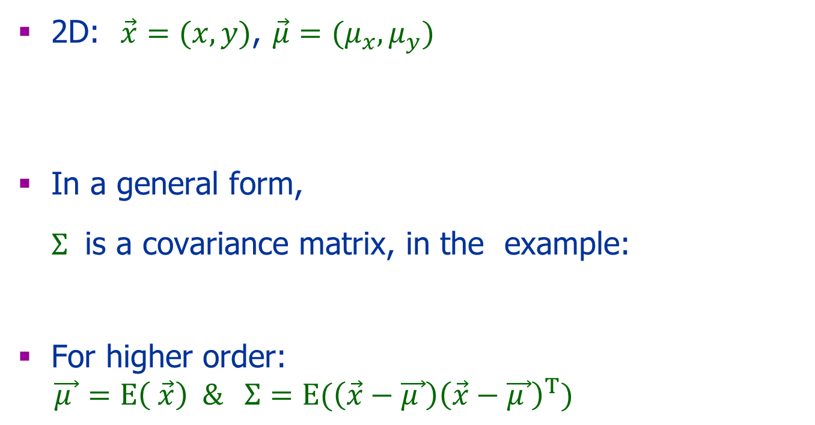
2D/3D Gaussian
2D:$\vec{x}=(x,y)$, $\vec{μ}=(μ_{x},μ_{y})$
In a general form, $Σ$ is a covariance matrix, in the example:
For higher order:
$\vec{μ }=E\left( \vec{x}\right) \& Σ={E(\left(\vec{x}−\vec{μ }\right)\left(\vec{x}−\vec{μ }\right)}^{T})$

Slide 25
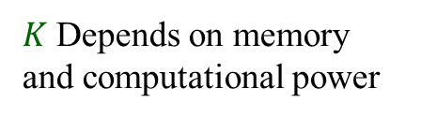
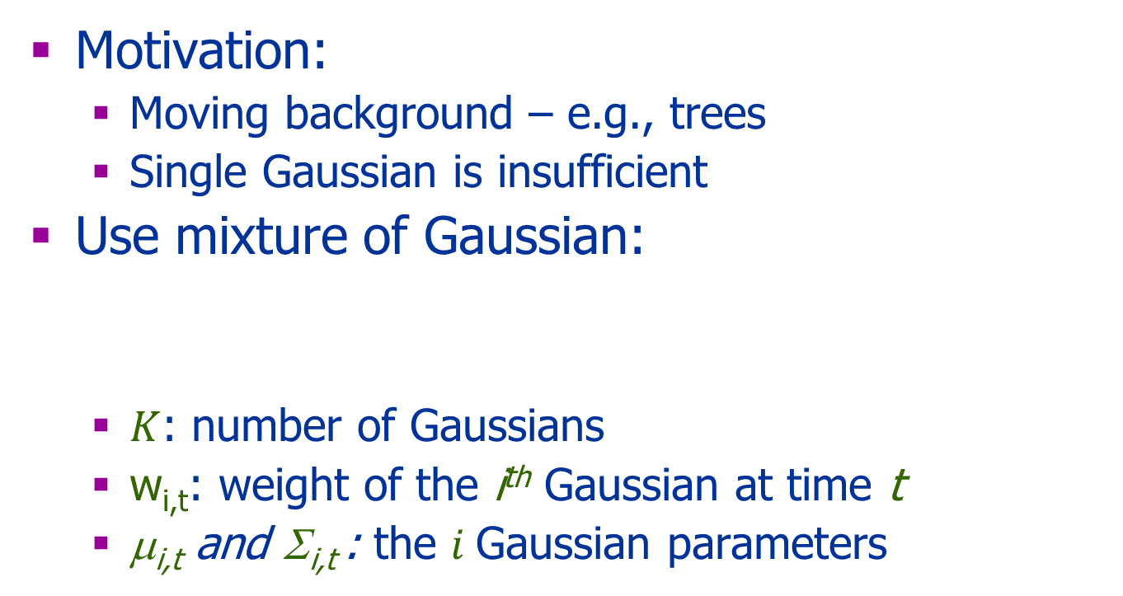
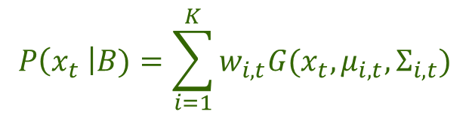
Gaussian Mixture Model (based on Stauffer et. al. 1999)
Motivation:
Moving background – e.g., trees
Single Gaussian is insufficient
Use mixture of Gaussian:
$K$: number of Gaussians
w_{i,t}: weight of the i^{th} Gaussian at time t
μ_{i,t} and Σ_{i,t} : the $i$Gaussian parameters
$K$ Depends on memory
and computational power
$$P\left(x_{t} \right|B)=\sum_{i=1}^{K}{w_{i,t}G(x_{t},μ_{i,t},Σ_{i,t})}$$

Slide 26

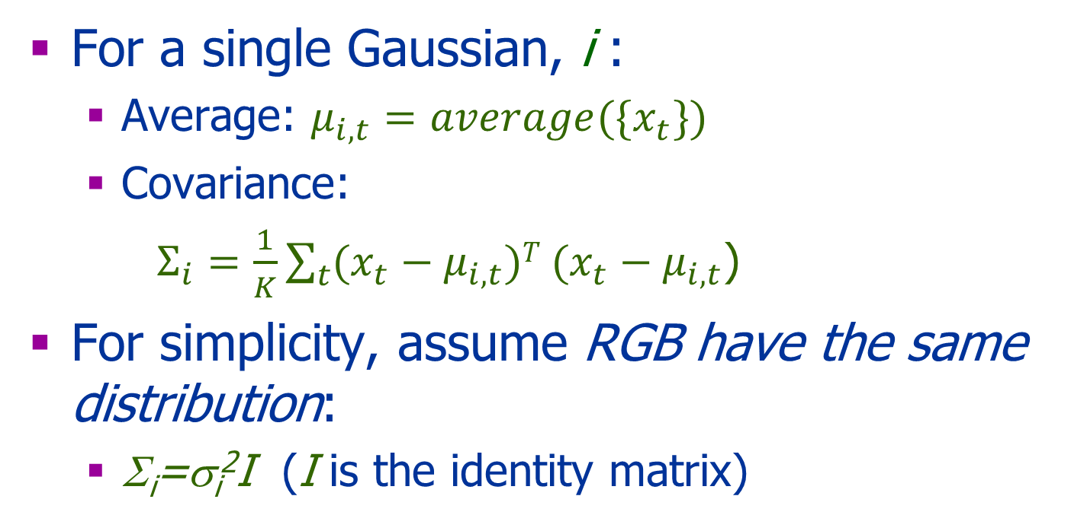
Setting the Parameters
For a single Gaussian, i :
Average: $μ_{i,t}={average({\{x}_{t}\})}_{}$
Covariance:
$Σ_{i}=\frac{1}{K}\sum_{t}{{(x}_{t}}−μ_{i,t}){T (x}_{t}−μ_{i,t}$)
For simplicity, assume RGB have the same distribution:
Σ_{i}=σ_{i}²I (I is the identity matrix)
What is ${\{x}_{t}\}$

Slide 27
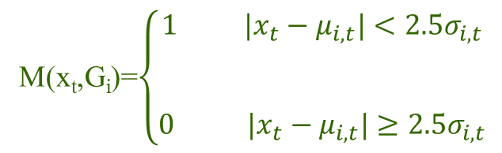
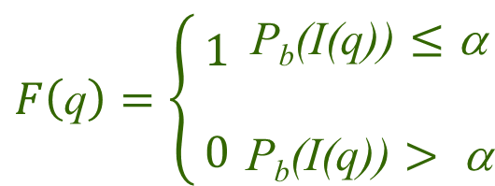
Background Update
K-means approximation: test x_{t} against each of its K Gaussians
A match with G_{i}:
Update weights
Update Gaussians
M(x_{t},G_{i})=$\left\{\begin{aligned}\begin{aligned}1 {|x}_{t}−μ_{i,t}|<2.5σ_{i,t} \\ \\ \end{aligned} \\ 0 {|x}_{t}−μ_{i,t}|≥2.5σ_{i,t}\end{aligned}\right.$
$$F\left(\text{q}\right)=\left\{\begin{matrix}\begin{aligned}1 \\ \end{aligned} \\ 0\end{matrix}\right.\begin{matrix}\text{P}\text{b}\text{(}\text{I}\text{(}\text{q}\text{))}≤\text{α} \\ \begin{matrix} \\ \text{P}\text{b}\text{(}\text{I}\text{(}\text{q}\text{))}> \text{α}\end{matrix}\end{matrix}$$

Slide 28
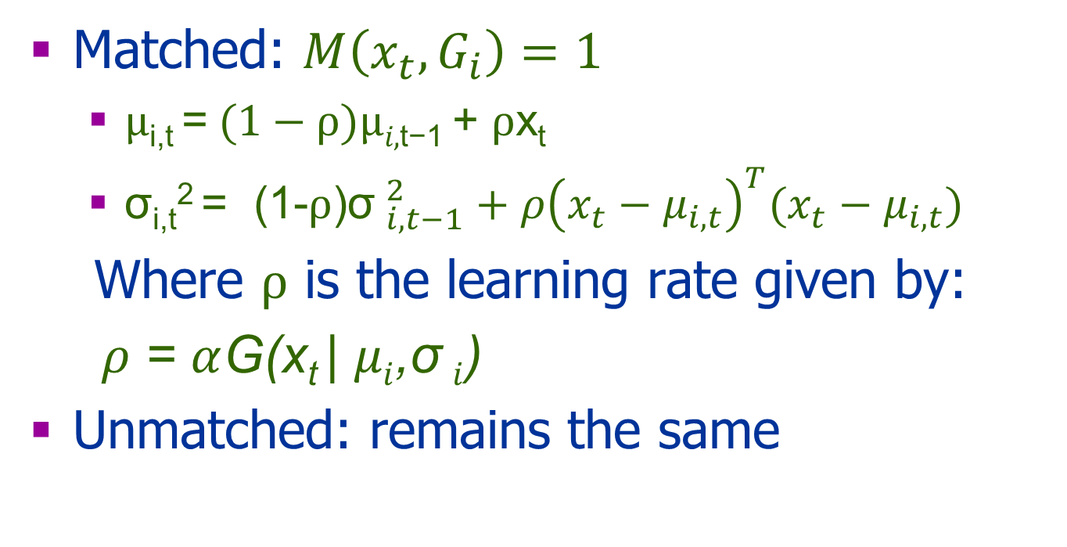

Update $μ_{i} \& σ_{i}$
Matched: $M\left(x_{t},G_{i}\right)=1$
$μ\text{i}\text{,}\text{t} \text{=} (1−ρ\text{)}μi\text{,}\text{t}\text{−}\text{1 }\text{+ }ρ\text{x}\text{t}$
σ_{i,t}² = (1-$ρ$)${\text{σ} }_{i,t−1}^{2}+ρ{\left(x_{t}−μ_{i,t}\right)}^{T}(x_{t}−μ_{i,t})$
Where $ρ$ is the learning rate given by:
$ρ$ = $α$G(x_{t} | $μi$,σ $i$)
Unmatched: remains the same

Slide 29
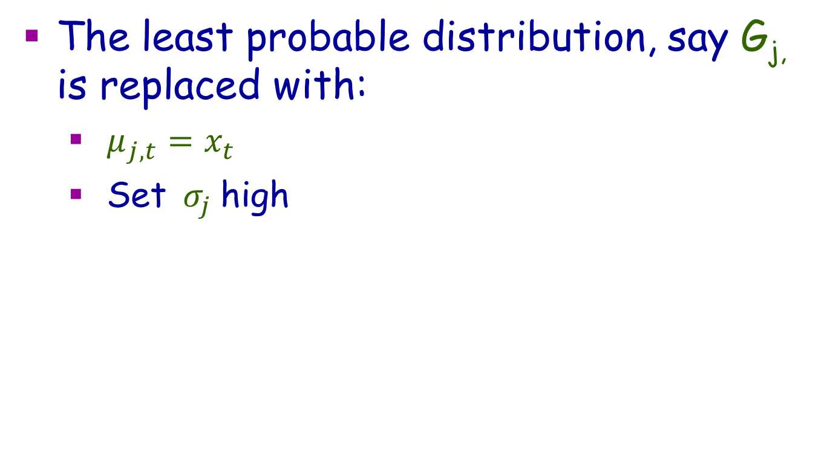

UnMatched: $∀i M\left(x_{t},G_{i}\right)=0$
The least probable distribution, say G_{j,} is replaced with:
$μ_{j,t}=x_{t}$
Set $σ_{j}$ high
Why?

Slide 30
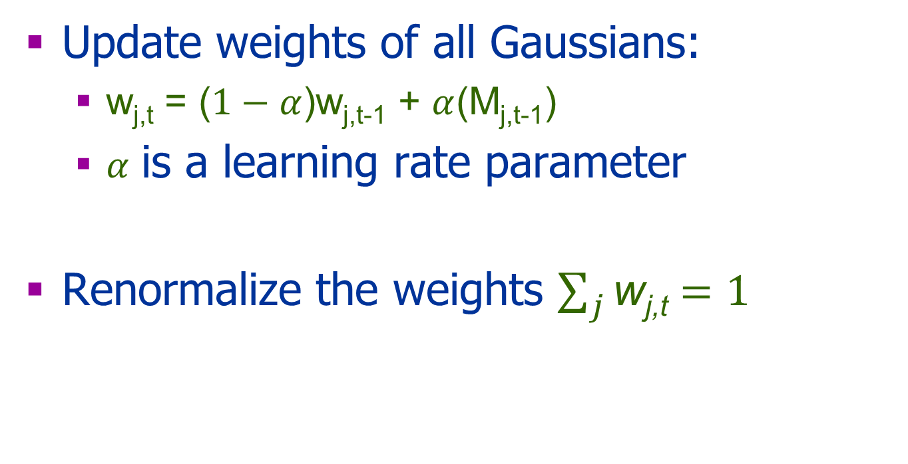
Update Weights
Update weights of all Gaussians:
w_{j,t} = ($1−α$)w_{j,t-1} + $α$(M_{j,t-1})
$α$ is a learning rate parameter
Renormalize the weights $\sum_{j}{\text{w}\text{j}\text{,}\text{t}}=1$
When does w_{j,t} increase ?

Slide 31
Questions
Can a new object become part of the background?
How it will affect the previously learned background?

Slide 32
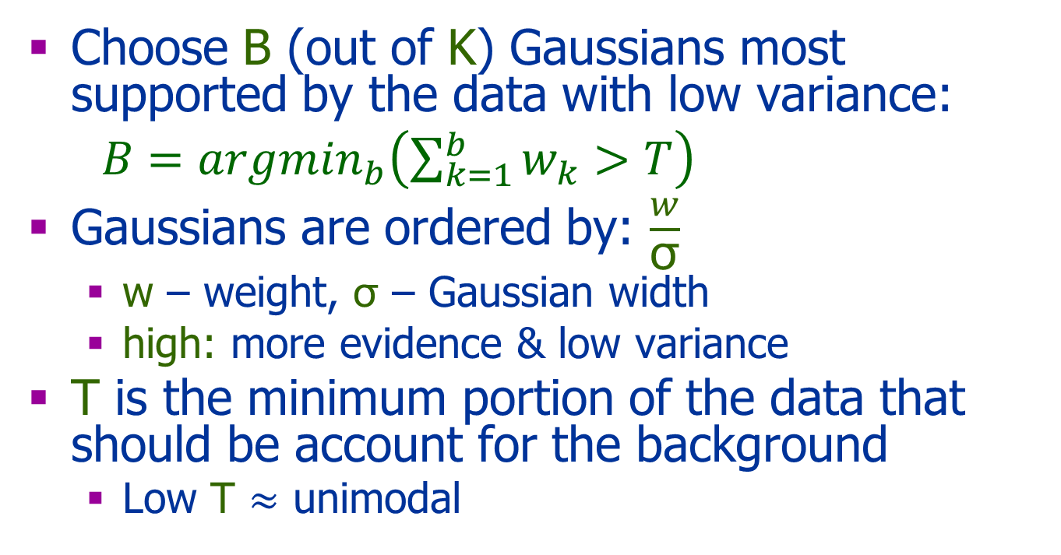
The Background
Choose B (out of K) Gaussians most supported by the data with low variance:
$B=argmin_{b}\left(\sum_{k=1}^{b}{w_{k}>T}\right)$
Gaussians are ordered by: $\frac{w}{\text{σ}}$
w – weight, $\text{σ}$ – Gaussian width
high: more evidence & low variance
T is the minimum portion of the data that should be account for the background
Low T $≈$ unimodal

Slide 33
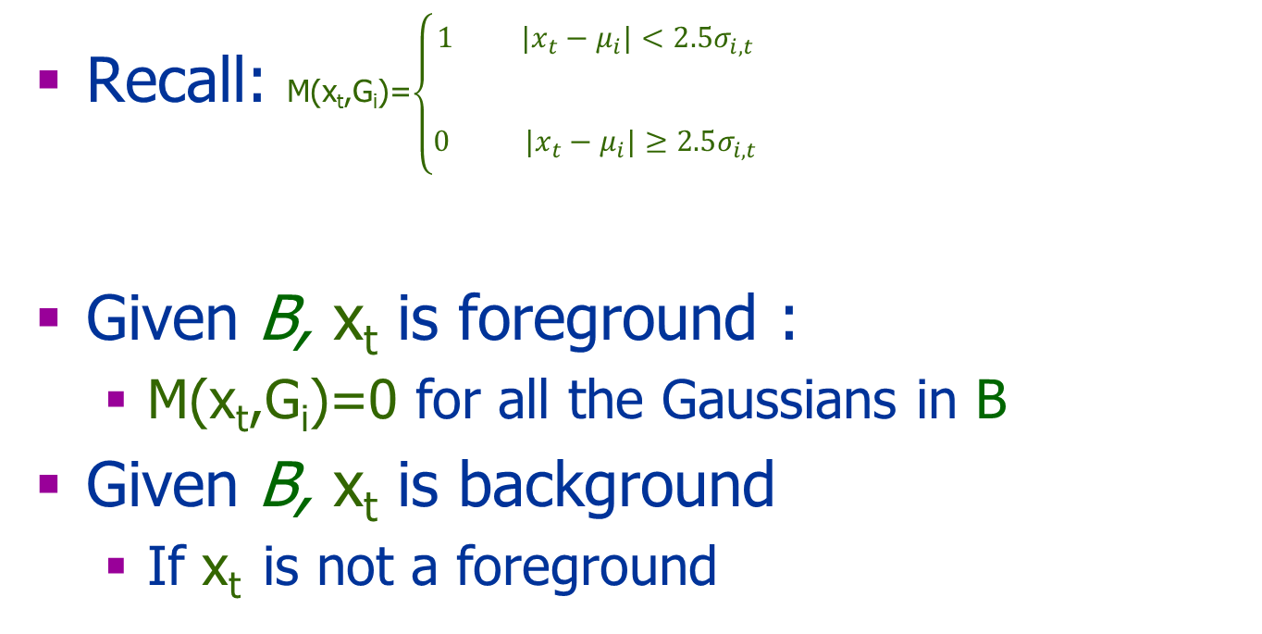
The Classification
Recall: M(x_{t},G_{i})=$\left\{\begin{aligned}\begin{aligned}1 {|x}_{t}−μ_{i}|<2.5σ_{i,t} \\ \\ \end{aligned} \\ 0 {|x}_{t}−μ_{i}|≥2.5σ_{i,t}\end{aligned}\right.$
Given B, x_{t} is foreground :
M(x_{t},G_{i})=0 for all the Gaussians in B
Given B, x_{t} is background
If x_{t} is not a foreground

Slide 34
Tradeoff Discussion
Slow adaptation:
Wide Gaussian
Inaccurate (too wide)
Low detection sensitivity
Fast adaptation:
Adapt quickly to targets
Background changes (e.g. branches) become false positives
Hard to estimate parameters of the background model

Slide 35
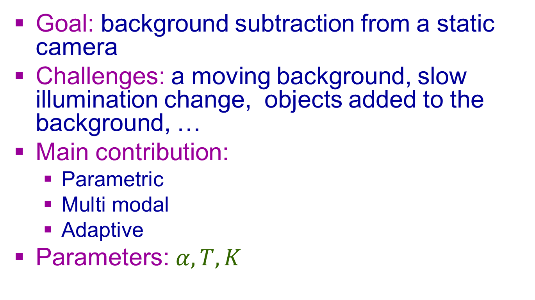
GMM: Summary
Goal: background subtraction from a static camera
Challenges: a moving background, slow illumination change, objects added to the background, …
Main contribution:
Parametric
Multi modal
Adaptive
Parameters: $α, T, K$

Slide 36
Additional Problems
Unstable camera
Moving camera
Changes of light
Moving background: Water, Trees, Clouds …
New stationary objects to the background and Removal of old stationary objects
Shadows of the moving objects

Slide 37
More Sophisticate Methods
Integrate motion information from several frames
Use patch descriptors (e.g., color histogram,HOGS)
Use features (e.g., contours)
Sophisticated segmentation methods

Slide 38
More Issues
Moving camera
Real time computation

Slide 39
Moving Camera – Making Life Simple
http://youtu.be/0L34HsXXU00

Slide 40
Summary
Optical Flow:
Assumptions
Pairs of images
Multi scale
Change Detection
Learn and model the background
Compare a frame to the BG
Mixture of Gaussians

Slide 41
References
Stauffer & Grimson. “Adaptive background mixture models for real-time tracking”. In IEEE Computer Vision and Pattern Recognition (CVPR) 1999.

